Slide 1
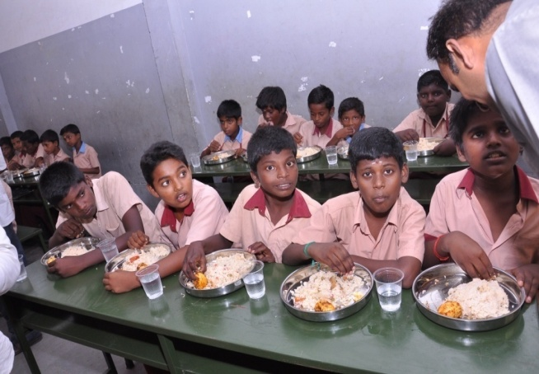
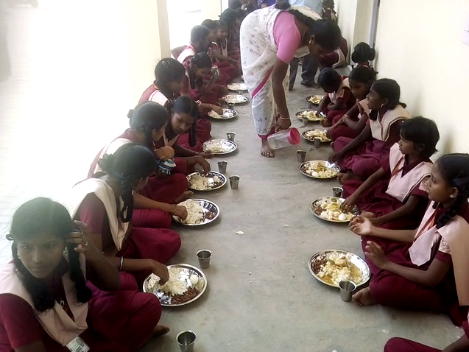
Government of Tamil Nadu
Mid Day Meal Scheme
PAB Meeting - 17.05.2018

Slide 2
Salient features of the scheme
Across the State of Tamil Nadu, 43,205 Noon Meal Centres
1,28,130 Noon Meal Employees have been engaged
45 lakhs children, studying in Primary & Upper Primary schools are provided with hot cooked nutritious variety meals on all school working days (220 days) inside the school campus itself.
6689 Children studying in National Child Labour Special Schools are also provided with Nutritious variety meals in 16 Districts for 312 days in a year.

Slide 3
Noon Meal Centres & Beneficiaries
Schools | Total No.of centres | 2018-19
 |  | Enrolled |  |  | Proposed
 |  | Govt & LB | Govt Aided | Total | Govt & LB | Govt Aided | Total
Primary | 26801 | 2013751 | 904728 | 2918479 | 1840665 | 687604 | 2528269
Upper Primary | 16134 | 1533684 | 765693 | 2299377 | 1464127 | 550357 | 2014484
NCLP | 270 | 6689 | 0 | 6689 | 6689 | 0 | 6689
Total | 43205 | 3554124 | 1670421 | 5224545 | 3311481 | 1237961 | 4549442
2017-18 | 43143 | 3661727 | 1720186 | 5381913 | 3425347 | 1264094 | 4689441

Slide 4
Plan preparation
The bottom up approach
The respective BDOs prepared the plan based on 3 field inspection by the block level officials and forwarded to District Collector.
The concerned PA (NMP) after random scrutinizing forwarded to the Commissionerate of Social Welfare with the concurrence of concerned District Collector.

Slide 5
Organisation Chart
Hon’ble Minister (SW & Nutritious Meal Programme)
Principal Secretary (SW & NMP Department)
Director (SW & NMP Department)
Joint Director (NMP)
Assistant Director (NMP)
Personal Assistant to District Collector
A.A.O., Assistant (2 Nos.), Typist, Data Entry Operator
Block Development Officer
Accounts Officer (NP-MDMS)
Asst. Accounts Officer (NP-MDMS)
Dpty. B.D.O.
Section Supt. (4 sections)
Data Entry Operator
Assistants (2 each sections)
N.M. Organiser
Data Entry Operators (3 Nos.)
Record Clerk / Office Assistant & Sweeper
Cook
Cook Assistant

Slide 6
Best Practices
Menu details
Days | 1st and 3rd wee Menu | 2nd and 4th week Menu
Monday | Vegetable Briyani + Pepper Egg | Sambar Sadham (Bisibalabath) + Onion Tomato Masala Egg
Tuesday | Black gram pulav + Tomato Masala Egg | Mixed Meal Maker & Vegetables Rice + Pepper Egg
Wednesday | Tomato Rice + Pepper Egg | Tamarind Rice + Tomato Masala Egg
Thursday | Rice + Sambar+Boiled Egg | Lemon Rice + Sundal + Tomato Egg
Friday | Curry Leaf Rice / Keerai Sadham + Masala Egg & Chilly Fried Potato | Rice + Sambar + Boiled Egg and Fried Potato

Slide 7
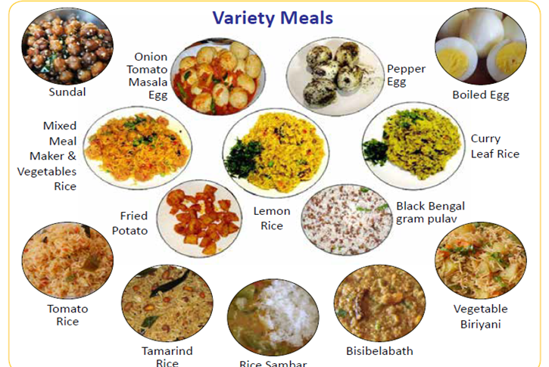

Slide 8
Nutrition Provided to the children under Mid Day Meals
S. No | Stage | GOI Norms |  | State Government Provision
 |  | Calories (In Kcl) | Protein (In gms) | Calories (In Kcl) | Protein (In gms)
1. | Primary | 450 | 12 | 553.30 | 18.12
2. | Upper Primary | 700 | 20 | 733.86 | 21.64

Slide 9
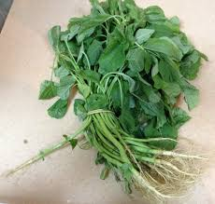
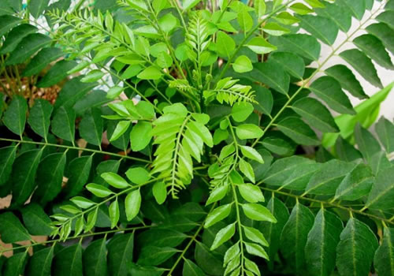
Best Practices - contd.,
Eggs are served to all enrolled beneficiaries from 1st std to 10th std on all school working days out of State budget.
Colouring scheme for eggs to prevent pilferage and staleness.
Banana weighing 100 gm is provided as an alternate to children who are not accustomed to eating egg
During 1st and 3rd week, on Friday Curry leaf rice (or) Keerai sadham should be provided for the children

Slide 10
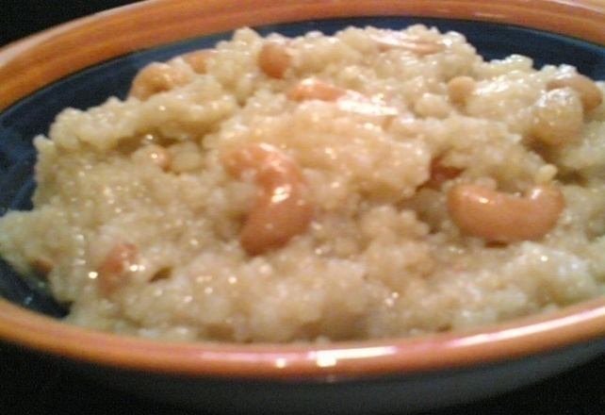
Best Practices - contd.,
During first and third week of a month, on Tuesday, 20 gms of ‘Black Bengal gram’ is provided to each child in the form of ‘Pulav’ During second and fourth week of a month on Thursday, 20 gm of Green gram is provided to each child in the form of ‘Sundal’. On all Fridays to increase the carbohydrate content, children are provided with 20 gm of chilly fried potato. During important occasions, Sweet Pongal is served to children by using Jaggery and ghee.

Slide 11
Best Practices – contd.,
Double Fortified Salt is used for cooking in order to prevent the children from Iodine deficiency thereby eradicating goiter.
Tamil Nadu Civil Supplies Corporation supplies rice, dhal, oil and salt at the doorsteps of the Noon Meal Centres in order to ensure quality and quantity.
4 set of school Uniforms, school Bags and Geometry box are provided for the children out of State funds for enhancing enrolment.
Out of State funds MDM is served to IX & X std children also.

Slide 12
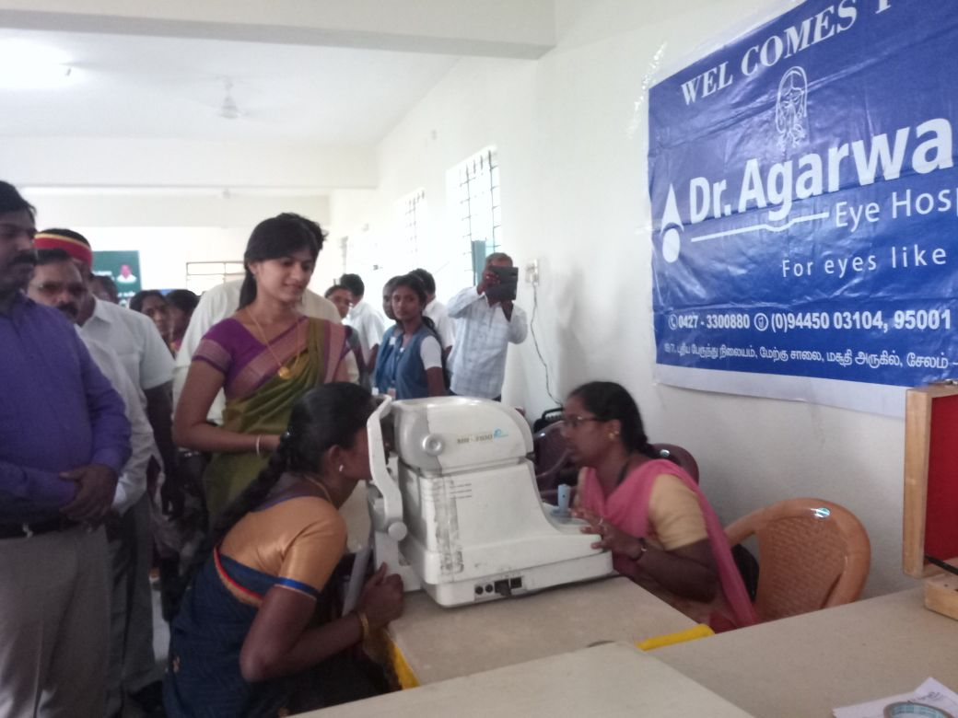
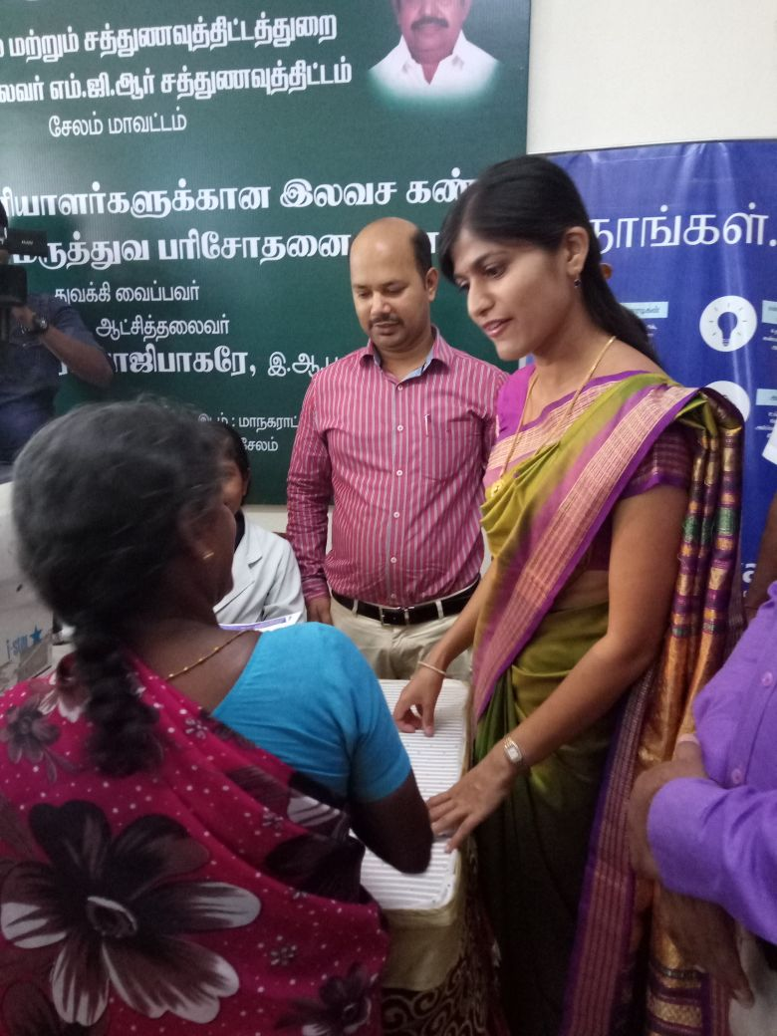
Health Camp for Noon Meal Employees District Initiatives

Slide 13
Food grain Management
Food Corporation of India
Tamil Nadu Civil Supplies Corporation
Noon Meal Centres
* Maintaining 45 days buffer stock at NMC level to provide meal without any delay

Slide 14
Benefits to Noon Meal Employees
1 | Special time scale of pay | 8 | Hill allowance & winter allowance
2 | Special monthly pension | 9 | Maternity leave
3 | Lumpsum amount | 10 | Family benefit fund
4 | Special provident fund | 11 | Funeral Assistance
5 | General provident fund | 12 | Compassionate ground appointment
6 | Festival advance | 13 | Pongal bonus
7 | New Health Insurance Scheme

Slide 15
Teachers / Noon Meal Employees assisting children in encouraging hand wash using soap

Slide 16
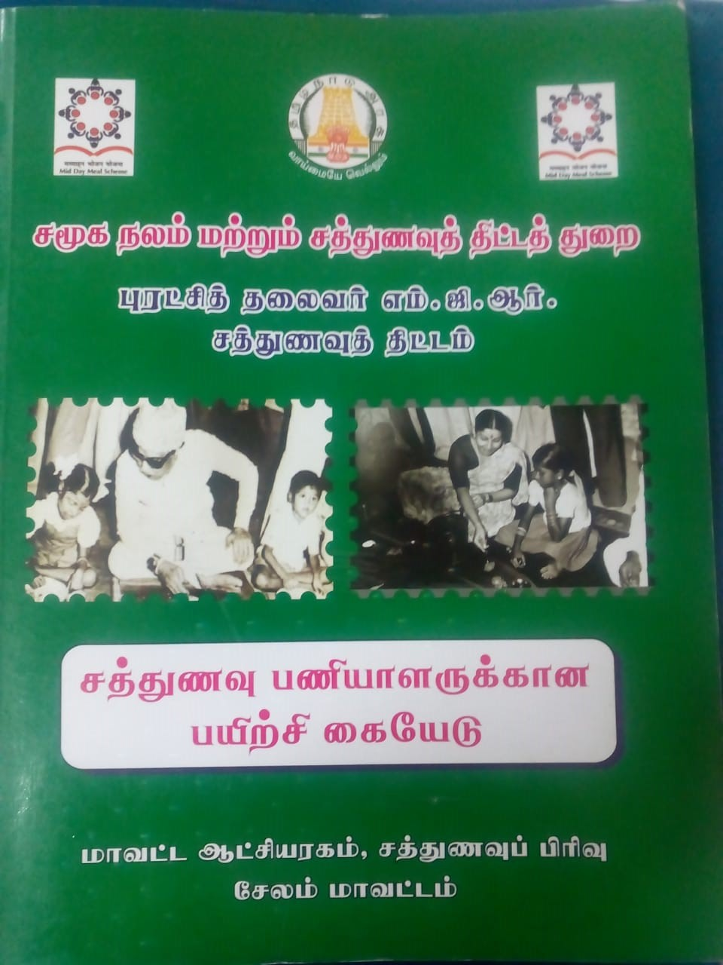
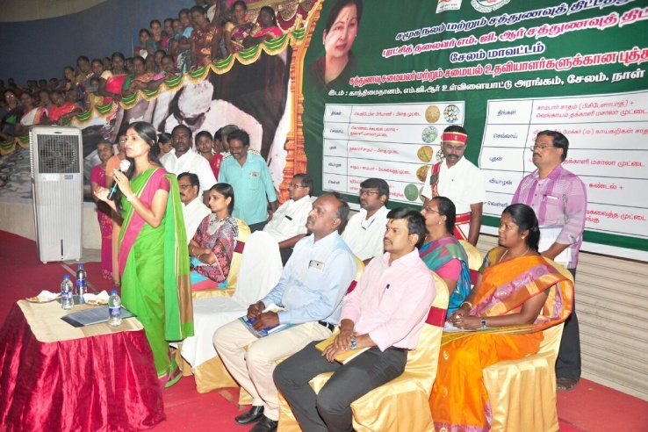
Training to Noon Meal Employees
Training programmes are organised at regular intervals to orient the employees on nutrition, health, personal hygiene like regular cutting of nails, washing their hands, cleaning of cooking and serving utensils, disposal of wastage, safety usage of LPG etc.,
Block level training on cluster basis.

Slide 17
Rashtriya Bal Swasthya Karyakram (RBSK)
The child health screening and early intervention services
To reduce child mortality from birth to 18 years.
School children in the age group of 6 to 18 years would be screened by mobile health teams for deficiencies, diseases, developmental delays including disability and adolescent health atleast once in a year.
9276197 children have been covered upto 12/2017 de-worming tablets have been issued the children, and so far 84461 students have been checked and distributed spectacles.
Notes:
r

Slide 18
Automated Monitoring System
This system is being implemented from September 2017.
Nearly 45% of H.M. are sending the SMS.
The School Education Department have been addressed to instruct all the H.M.s to send the SMS regularly.
The best performing Districts Tiruvannamalai and Salem have been appreciated and the District Collectors were given appreciation letter.

Slide 19
Expenditure upto March 2018
Rs in crore
S. No | Components | Fund released by GOI including OB | Expenditure | %
1. | Cost of Foodgrains | 37.82 | 25.28 | 67
2. | Cooking Cost | 312.17 | 307.25 | 98
3. | Honorarium to cook-cum-helper | 76.88 | 76.88 | 100
4. | Transport Assistance | 9.45 | 5.13 | 54
5. | MME | 7.85 | 7.85 | 100
 | Total | 444.17 | 422.39 | 93

Slide 20
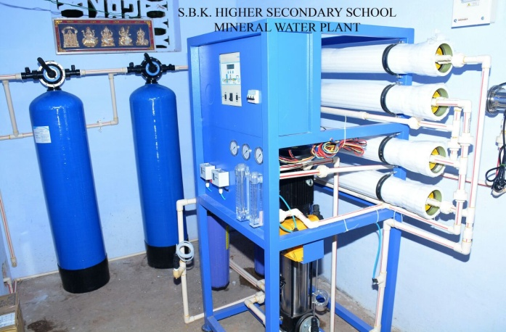
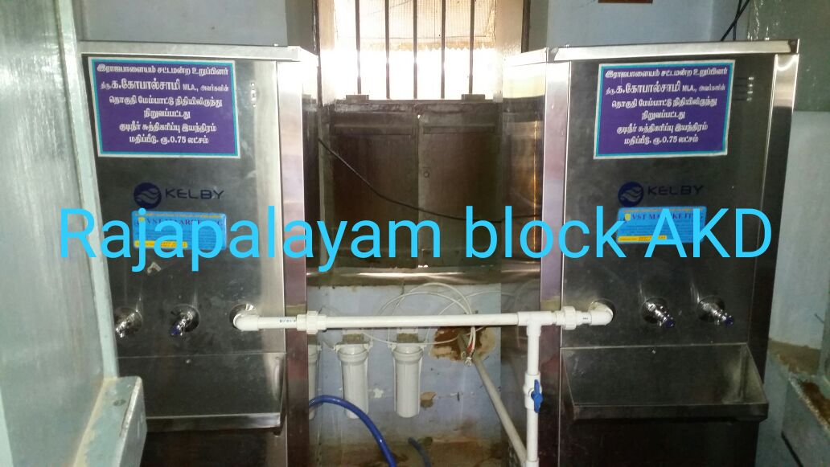
Availability of Water filtration facilities in the Noon Meal Centres
No.of Noon Meal Centres having water filtration facility – 9097
R.O. - 8568
U.F. – 33
U.V / e- boiling – 1
Candle filter purifier – 495
9097
Water purification facilities have been done with the help of Corporates, school development fund etc.,
Source of fund
By way of Govt fund – 6657 centres
By way of CSR fund – 842 centres
By way of Donations –1598 centres

Slide 21
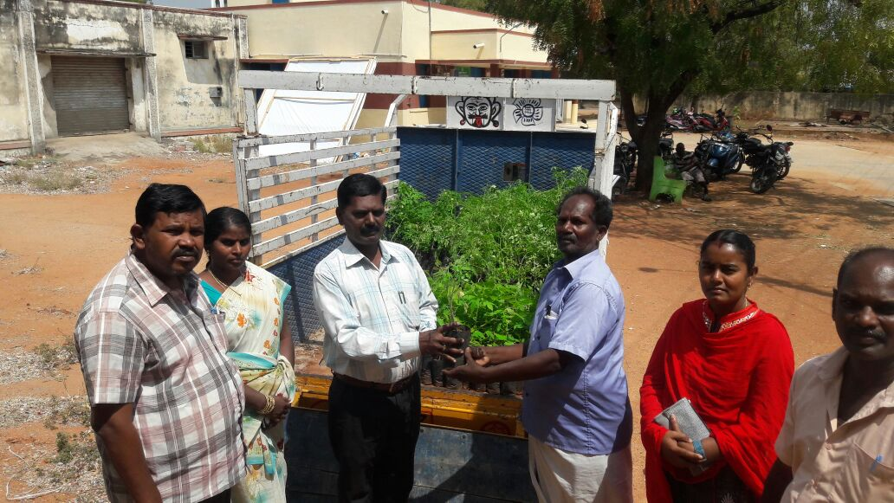
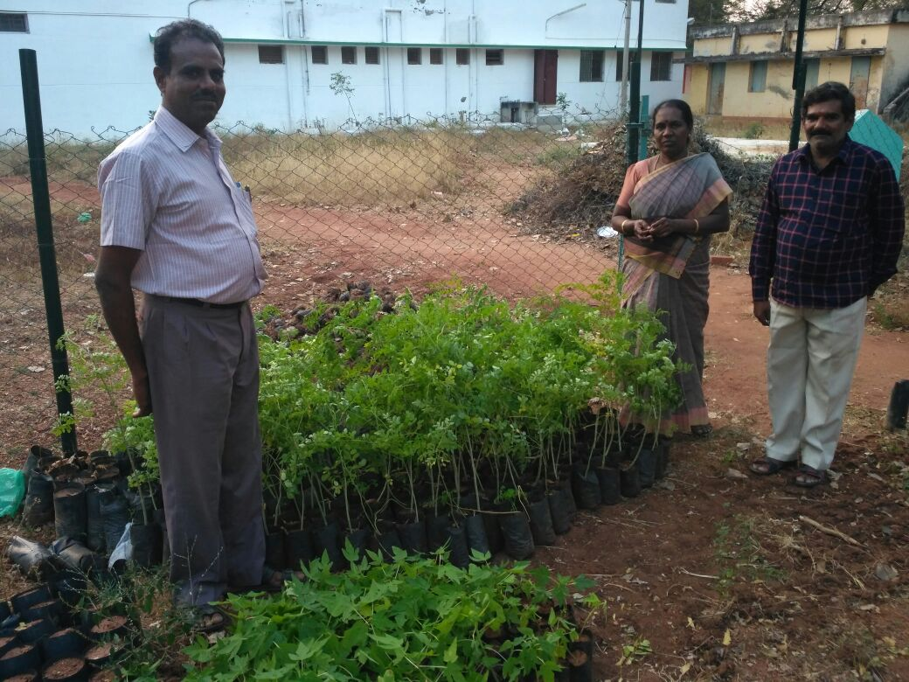
Kitchen Garden
As a special Initiative the Department of Horticulture has allotted a sum of Rs. 25.00 lakhs for providing seedlings to the Noon Meal and Anganwadi Centres. Accordingly 41780 drumstick seedlings and 41315 Papaya seedlings have been distributed to the Noon Meal Centres in Tamil Nadu.

Slide 22
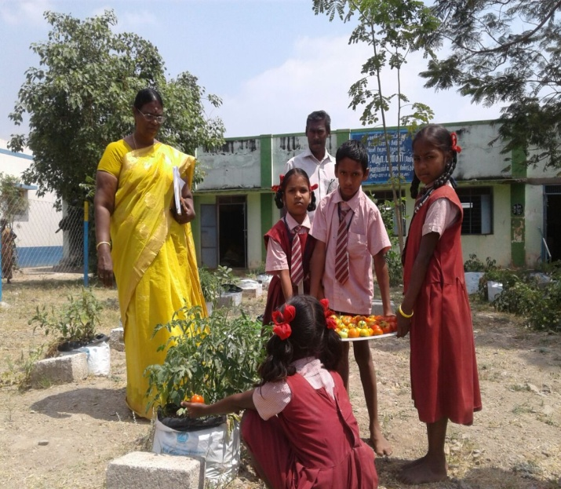
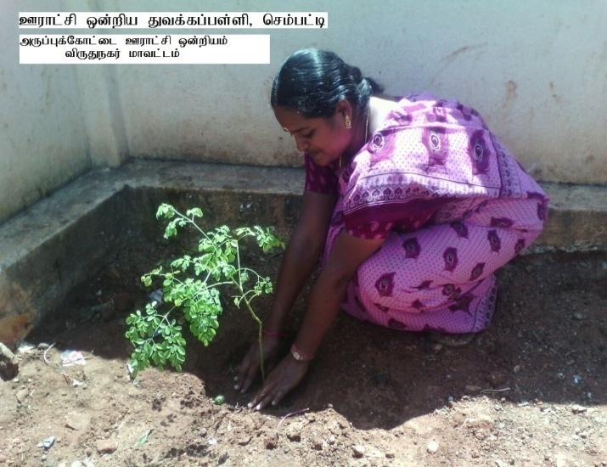
School Headmaster supervising Kitchen garden
Noon Meal Employee planting Murungai in the premise of NMC.

Slide 23
Noon Meal Centres
Proposal for 2018-19
Stage | 2017-18 | 2018-19 | Diff., | Remarks
Primary | 26810 | 26801 | -9 | During the academic year 2017-18, 15 schools were closed and 77 schools were upgraded as Upper Primary.
Upper Primary | 16064 | 16134 | +70
NCLP | 269 | 270 | +1 | In Krishnagiri district 1 NCLP centre included.
Total | 43143 | 43205

Slide 24
Meal Cost fixed by GOI for per beneficiary / per day (excluding labour and administrative charges)
In Rs.
Class | MDM Norms (60:40) | Centre 60% | State 40% | Additional State contribution | Total
Primary (1-5 Std) | 4.13 | 2.48 | 1.65 | 2.98 | 7.11
Upper Primary (6-8 Std) | 6.18 | 3.71 | 2.47 | 1.03 | 7.21
9th & 10th | - | - | 100% contribution by State Government |  | 8.78
For 9 & 10th Std the entire expenditure is met out of State funds only.

Slide 25
Proposed Budget for the year 2018-19
Rs. In crore
S. No | Components | Ratio | Amount proposed for 2018-19 in the ratio 60:40
 |  |  | Centre | State
1. | Cost of Foodgrains | 100% GOI | 35.97 | 0
2. | Cooking Cost | 60:40 | 317.47 | 211.53
3. | Honorarium to cook-cum-helper | 60:40 | 76.88 | 51.25
4. | Transport Assistance | 100% GOI | 8.99 | 0
5. | MME | 1.8% of the central share | 7.91 | 0
 | Total |  | 447.21 | 262.78

Slide 26
Special Initiatives
Introduction of Iron Fortified Rice in Ramnad and Virudhunagar Districts.
The Districts of Ramanathapuram and Virudhunagar have been selected as Aspirational District by NITI Aayog for developing all parameters including Nutritional intervention.
The total cost for implementing the scheme is Rs.161.82 lakhs.
2. Construction of 2 Dining Halls in each District under Mid Day Meal Programme
Total funds required for the construction of 1 Dining Hall - Rs.13.05 lakh
No. of Dining Halls proposed to be built in each District - 2 Dining HallsX32 Districts= 64
Total amount required for constructing 64 Dining Halls - Rs.835.20 lakhs
3. Setting up of Water Purifiers in the Noon Meal Centres in Tamilnadu
Total cost required for providing 1000 litre capacity water filter = Rs.3.00 lakhs
Total cost required for providing 500 litre capacity water filter = Rs.1.85 lakhs
500 litres capacity of Water filters may be provided to 34100 Noon Meal Centres.
No. of Noon Meal Centres for which water filtration facility to be provided 34100 Centres
Total Amount required = Rs.630.85 lakhs.

Slide 27
Special Initiatives contd.,
4. Providing Millets under Mid Day Meal Programme (Ramnad & Virudhunagar District)
The requirement of funds for providing millets is as follows:
Total No of Primary children - 142632
Cost for 50 gms of millets - Rs.7.00
Total no of days to be fed - 210 days
Total amount required - Rs.2096.69 lakhs
5. Setting up of Kitchen garden in the Noon Meal Centres
The total cost required for providing of kitchen garden is as follows:
Amount required for setting up of a kitchen garden - Rs.1,000/-
Total no. of Noon Meal Centres - 43205
Total amount required - Rs.432.05 lakhs

Slide 28
Thank You

